Slide 1
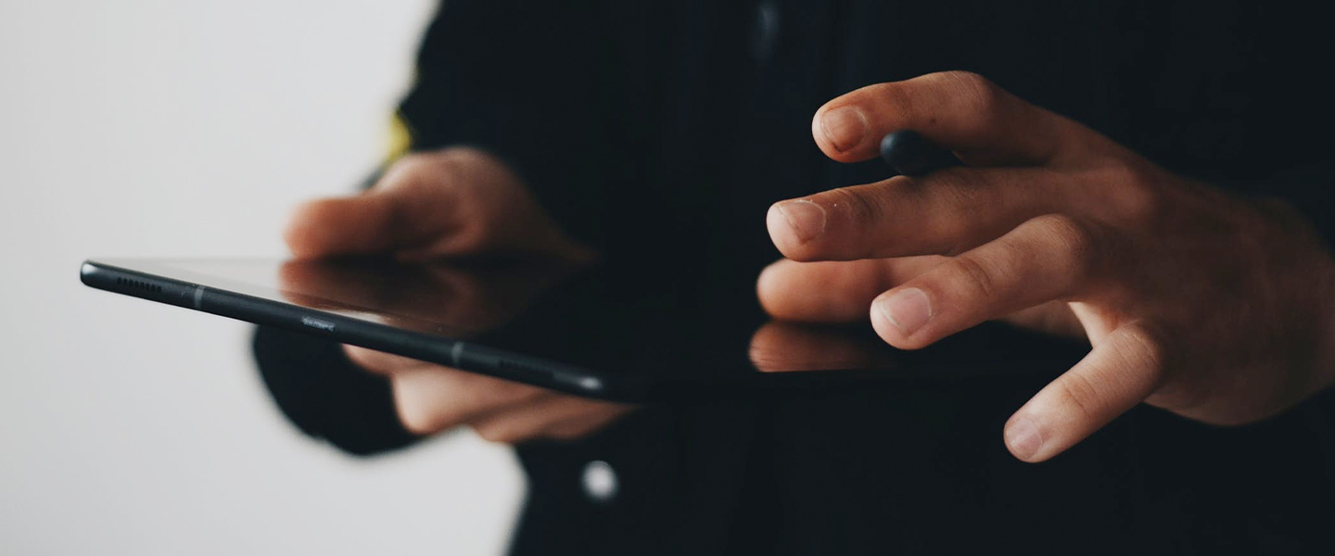
TECHNICAL PRESENTATION OF THE PROJECT ON
DIGITAL PRESCRIPTION MANAGEMENT SYSTEM

Slide 2
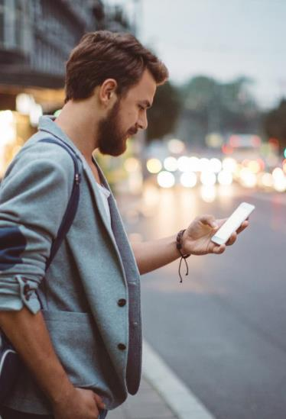
Agenda
Introduction to the project
Mobile Application Development
Introduction to Android
Software Model Adopted
Technology
Java
Introduction to XML
Development Tools
Android Studio
FireBase
Features
Scope of the system
E-R Diagram
Data Flow Diagram
Snapshot of developed application
Reference

Slide 3
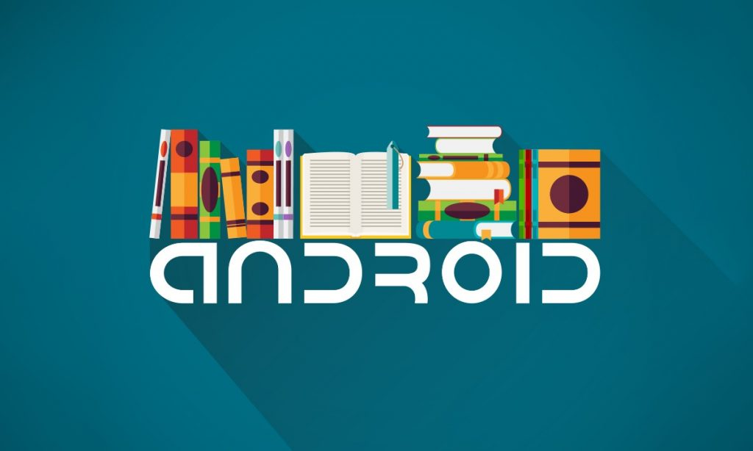
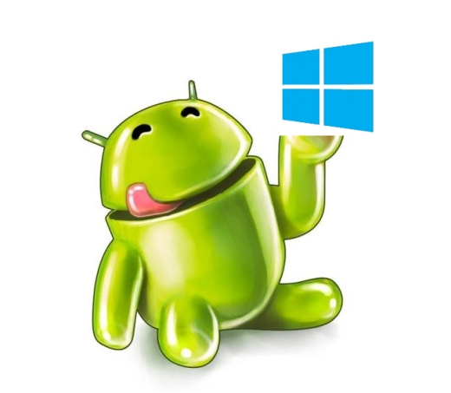
Introduction to the project
Digital prescribing is an important part of the nation's push to enhance the safety and quality of the prescribing process. E-prescribing allows providers in the ambulatory care setting to send prescriptions electronically to the pharmacy and can be a stand-alone system or part of an integrated electronic health record system. It make the thing digital , secured and provide more efficient process for users treatment and maintain a perfect flow of treatment.

Slide 4
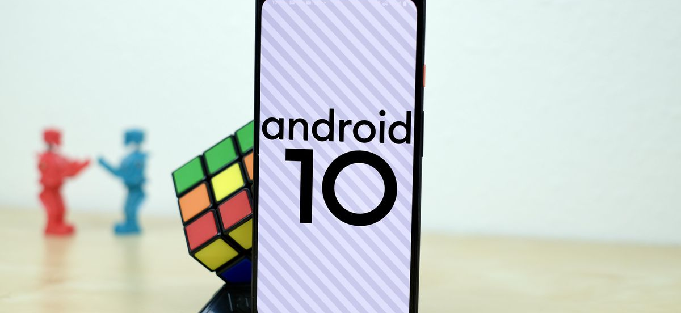
Mobile Application Development (MAD)
Few reasons to go MAD…
Smart Phones
Internet access anywhere
Social networking
Millions of mobile users
Open standards

Slide 5


Introduction to Android
Open software platform for mobile development
A complete stack – OS, Middleware, Applications
An Open Handset Alliance (OHA) project
Powered by Linux operating system
Fast application development in Java
Open source under the Apache 2 license

Slide 6
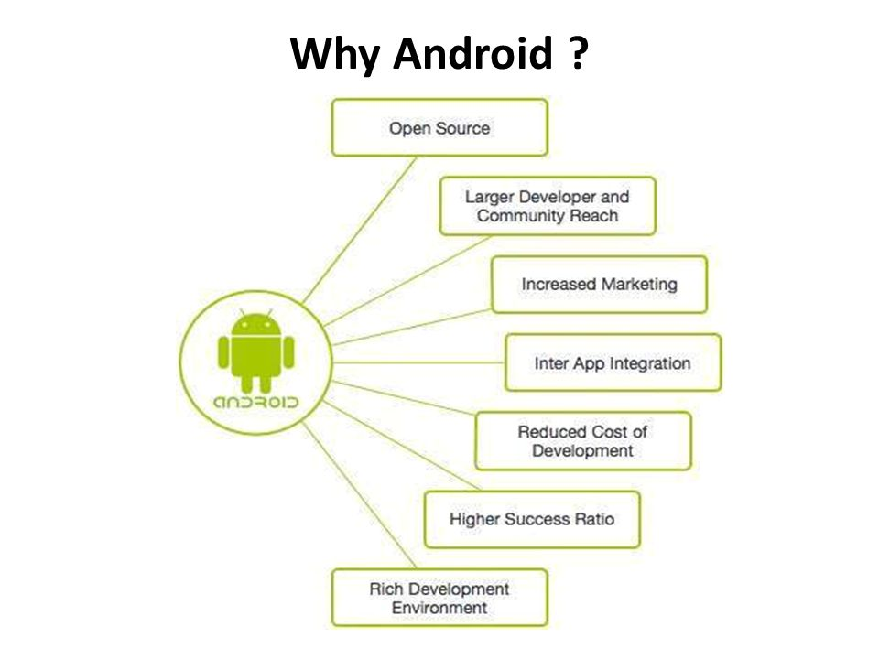

Slide 7
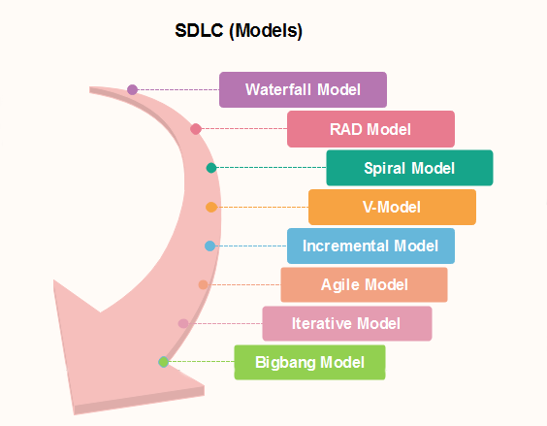
Software Model Adopted
Every model is used in different cases based on its features. Here in our project we basically adopted the Iterative Software Process Model.
An iterative life cycle model does not attempt to start with a full specification of
requirements by first focusing on an initial, simplified set user features, which
then progressively gains more complexity and a broader set of features until the targeted system is complete. In other words, the iterative approach begins by specifying and implementing just part of the software, which can then be
reviewed and prioritized in order to identify further requirements. This iterative
process is then repeated by delivering a new version of the software for each
iteration.
We had started our development with some requirement and that was not the
final set of the requirement of this project. After implementing these requirement
we add some another requirement to that set and continue our development
process. In this way we implement a requirement set , tested it and add some
more requirement and again developed and tested. In every phase or in every
iteration the app was updated and a new version was launched. So, we can say, Iterative Software Process model is adopted by us to develop this project.

Slide 8

Technology Used
Java: Java is one of the most established programming languages when it comes to developing dynamic content. ...

Slide 9
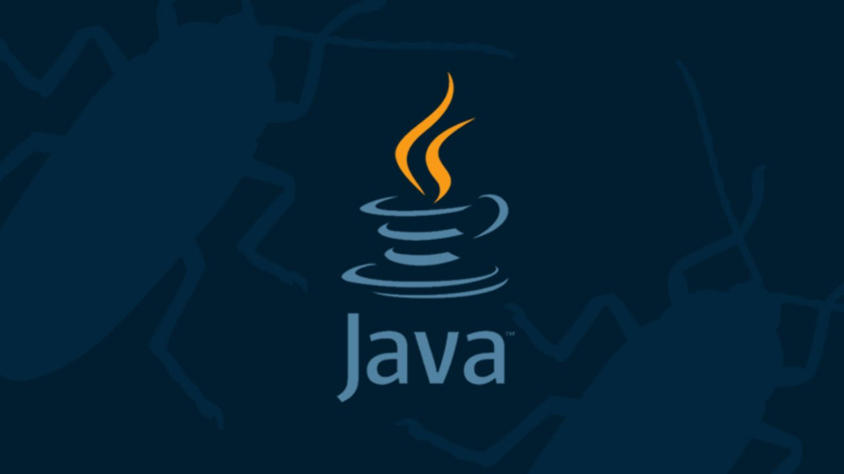
Java
“A class, in java, where we teaches objects how to behave”
Java is a general-purpose, class-based, object-oriented programming language designed for having lesser implementation dependencies. It is a computing platform for application development. Java is fast, secure, and reliable, therefore. It is widely used for developing Java applications in laptops, data centers, game consoles, scientific supercomputers, cell phones, etc.
There were five primary goals in the creation of the Java language:
It must be simple, object-oriented, and familiar.
It must be robust and secure.
It must be architecture-neutral and portable.
It must execute with high performance.
It must be interpreted, threaded, and dynamic.

Slide 10
Introduction to XML
XML stands for Extensible Markup Language. It is a markup language much like HTML. XML was designed to store and transport data and to be self-descriptive. XML stores data in plain text format. This provides a software- and hardware-independent way of storing, transporting, and sharing data.
XML also makes it easier to expand or upgrade to new operating systems, new applications, or new browsers, without losing data.
With XML, data can be available to all kinds of "reading machines" like people, computers, voice machines, news feeds, etc.
Extensible Markup Language

Slide 11
Development Tools
Android Studio
Android SDK
The Emulator

Slide 12
The Android SDK is a collection of software development tools and libraries required to develop Android applications. Every time Google releases a new version of Android or an update, a corresponding SDK is also released which developers must download and install.
Android SDK:
The Android Emulator simulates Android devices on your computer so that you can test your application on a variety of devices and Android API levels without needing to have each physical device. The emulator provides almost all of the capabilities of a real Android device.
The Emulator:

Slide 13
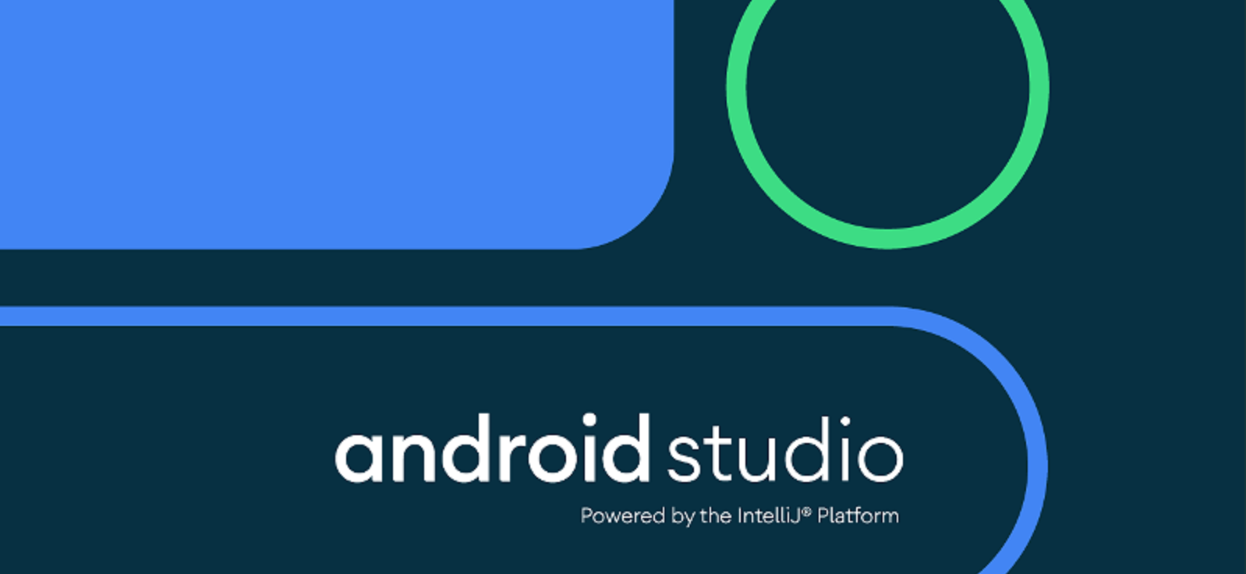
Introduction to Android Studio
Android Studio is the official Integrated Development Environment (IDE) for Google's Android operating system, built on JetBrains' IntelliJ IDEA software and designed specifically for Android Development It is available for download on Windows, macOs and Linux based operating systems or as a subscription-based service in 2020. It is a replacement for the Eclipse Android Development tool (E-ADT) as the primary IDE for native Android application development.
Android Studio supports all the same programming languages of IntelliJ (and CLion) e.g. Java, C++, and more with extensions, such as Go, and Android Studio 3.0 or later supports Kotlin and "all Java 7 language features and a subset of Java 8 language features that vary by platform version.
Gradle-based build support
Android-specific refactoring and quick fixes
Lint tools to catch performance, usability, version compatibility and other problems
ProGuard integration and app-signing capabilities
Template-based wizards to create common Android designs and components
A rich layout Editor that allows users to drag-and-drop UI components, option to preview layouts on multiple screen configurations
Support for building Android wear apps
Built-in support for Google Cloud Platform, enabling integration with Firebase Cloud Messaging (Earlier 'Google Cloud Messaging') and Google App Engine
Android Virtual Device (Emulator) to run and debug apps in the Android studio.

Slide 14
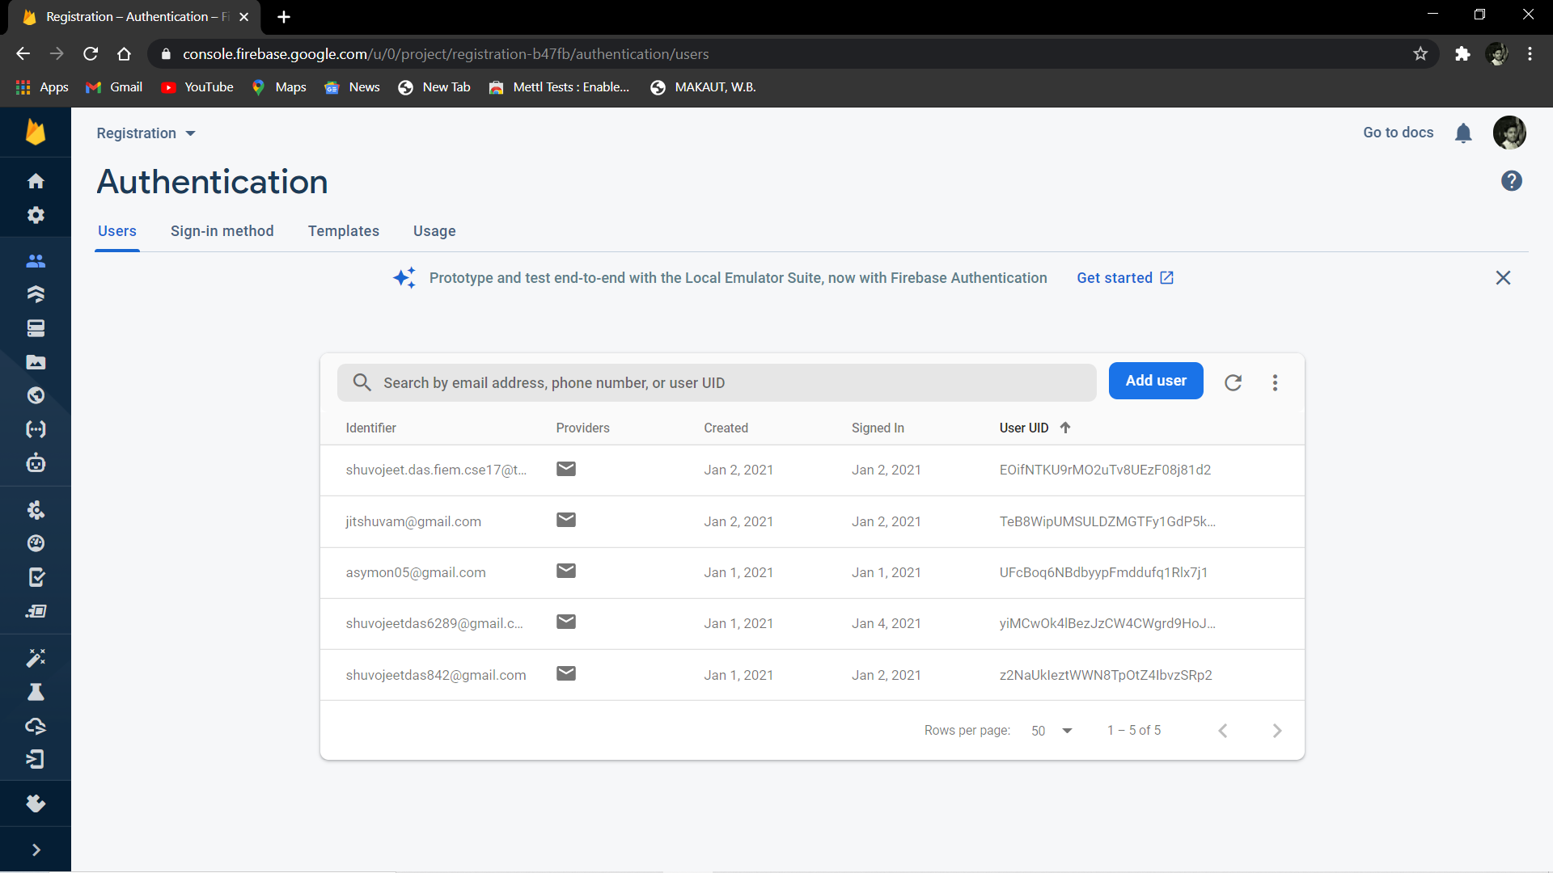
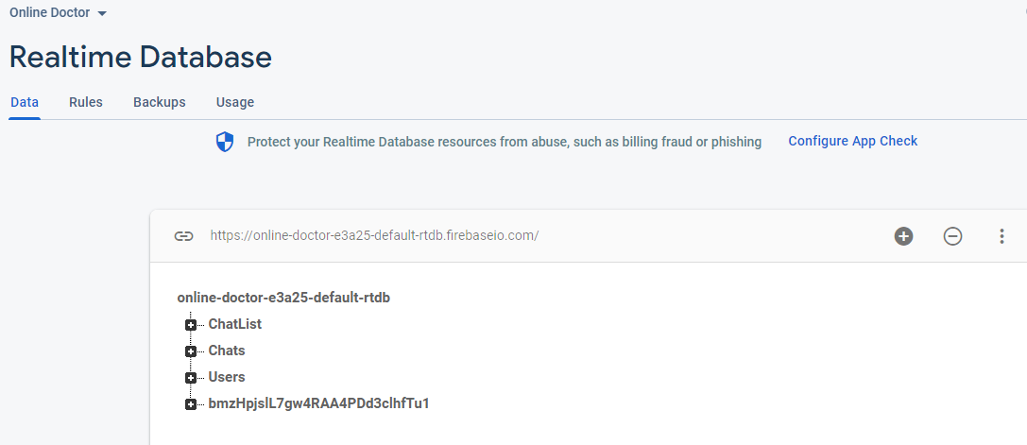
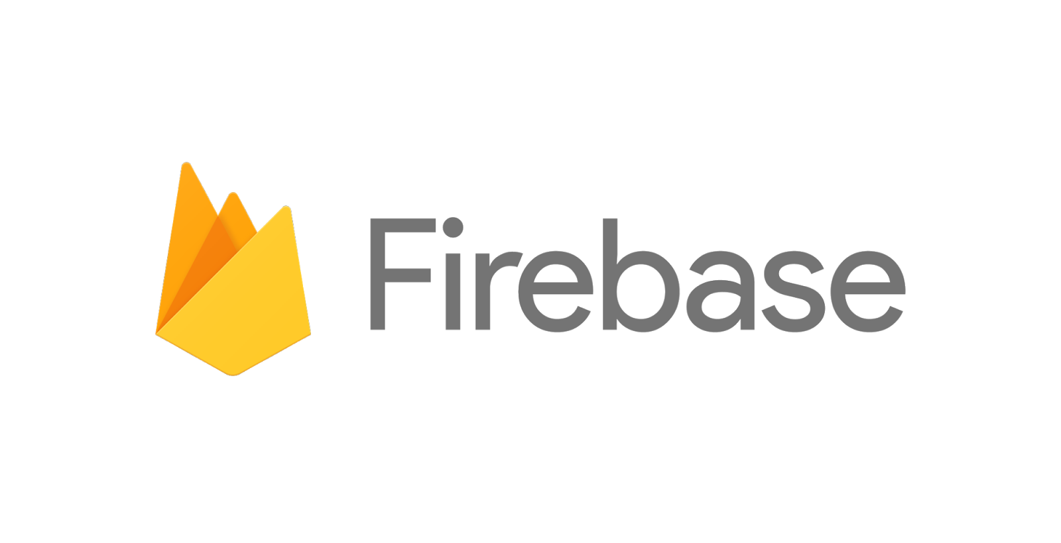
FireBase
We use firebase to store the details of user. When a user create a account, then the login credential will be store into firebase database and the account will be created.
Details of registered users in the database
Firebase is a platform developed by Google for creating mobile and web applications. Firebase is Google's mobile application development platform that helps you build, improve, and grow your app. Here it is again in bigger letters, for impact: Firebase is Google's mobile application development platform that helps you build, improve, and grow your app. The Firebase SDK supports programming in C++, Java, JavaScript, JavaScript/Node. js, Objective-C, and Swift. Angular, Backbone, Ember and React are supported through bindings to the database.
Realtime Database of Users

Slide 15
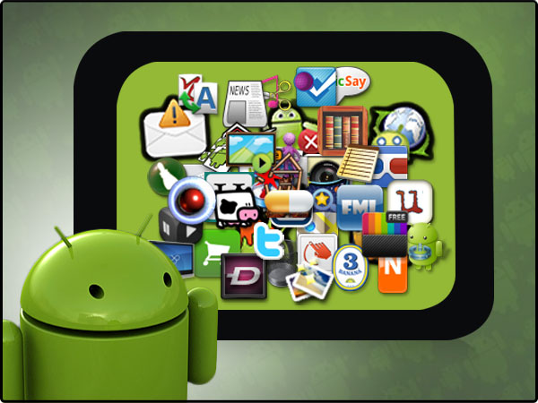
Features
Firstly, the application allows user to create their account as a doctor or patient with their necessary details.
After filling the all details a verification mail will be sent to the users given mail address and users have to click that link to verify the email address. Without email verification one cannot get the access of his/her account.
Whenever a doctor want to login his account he or she have to provide his registration id which was given and verified at the time of registration.
After creating an account a doctor have to edit his specialties, experiences, fees to get the patient appointment. And the doctor can also upload his profile photo and cover photo for identification.
On the other side, it will recommend all the registered doctors, to the patient ensuring a top- class treatment.
Then it will allow patient to view the profile of a doctor to aware of the doctor’s specialties, experiences, age, phone number, email address and the doctor’s fees.
If the patient want to take advise from that particular doctor then he or she must pay the doctor’s fees from this application via Google Pay.
The application will provide a platform where the patient and doctor can communicate via live chat.
There is a chat list in users account and whoever message him or her it will appear in that chat list.
After consulting with doctor this application will allow the doctor to create a digital prescription using voice or text and can send this prescription via email using this application.
After all that the patient and the doctor can sign out from this application.

Slide 16
SCOPE OF THE SYSTEM
We will provide the best functionalities to our project. Our project is all about providing the digital way to consult a doctor.
The application provides all facilities to the doctor as well as the patient to communicate virtually. Firstly, the application allows an user to create their account as a doctor or patient with their necessary details. Then it will recommend all the registered doctors, to the patient ensuring a top-class treatment. Then it will allow patient to pay the doctor fees via Google pay from this application. The application will provide a platform where the patient and doctor can communicate via live chat. After consulting with doctor this application will allow the doctor to create a digital prescription using voice or text and can send this prescription via email using this application.

Slide 17
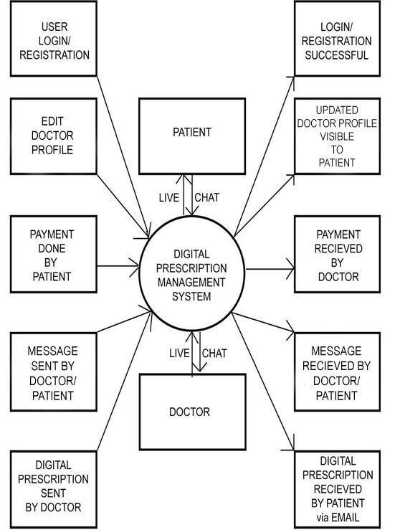
Data Flow Diagram
DFD OF THE SYSTEM

Slide 18
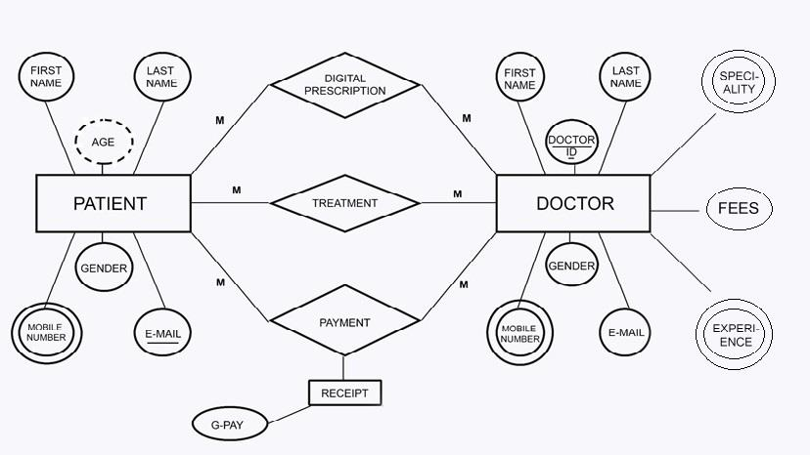
Entity Relationship Diagram
ER DIAGRAM OF THE SYSTEM

Slide 19
Snapshots
The snapshots will give us a clear view of our developed application…

Slide 20
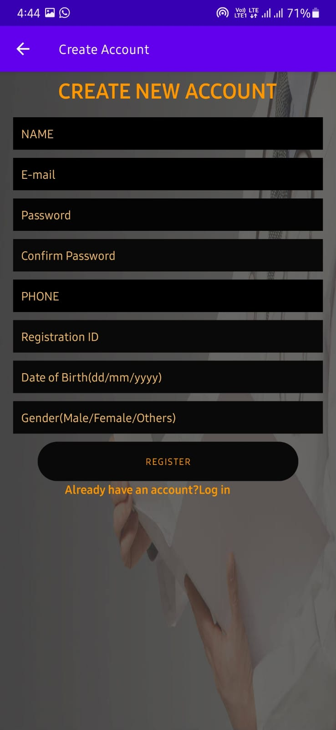
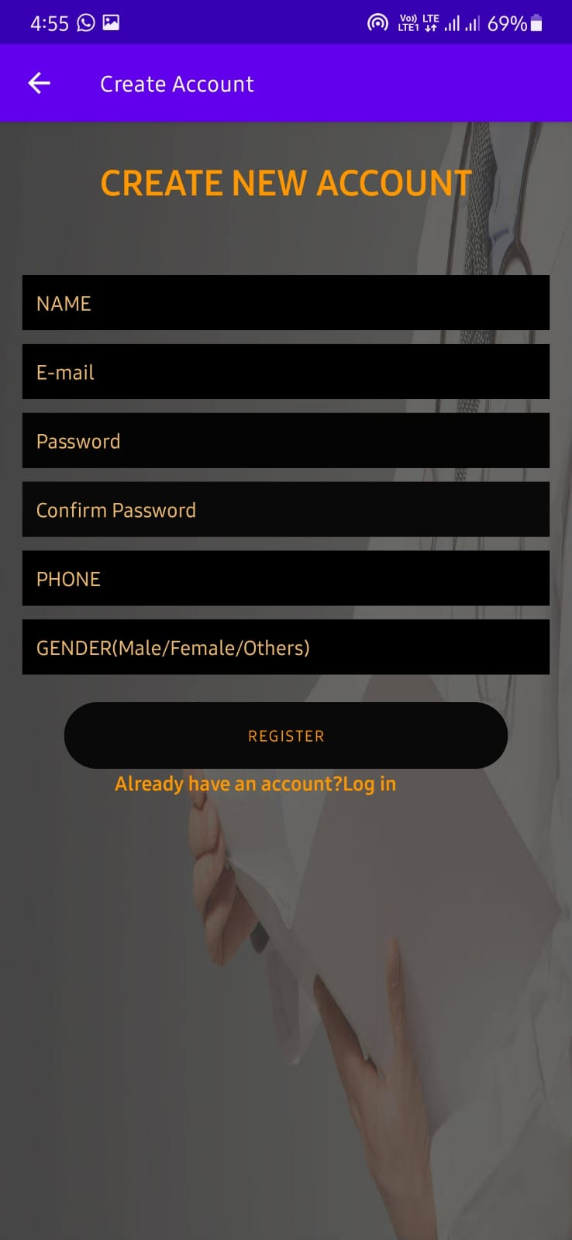
Registration View
When Doctor want to create new account…
When Patient want to create new account…

Slide 21
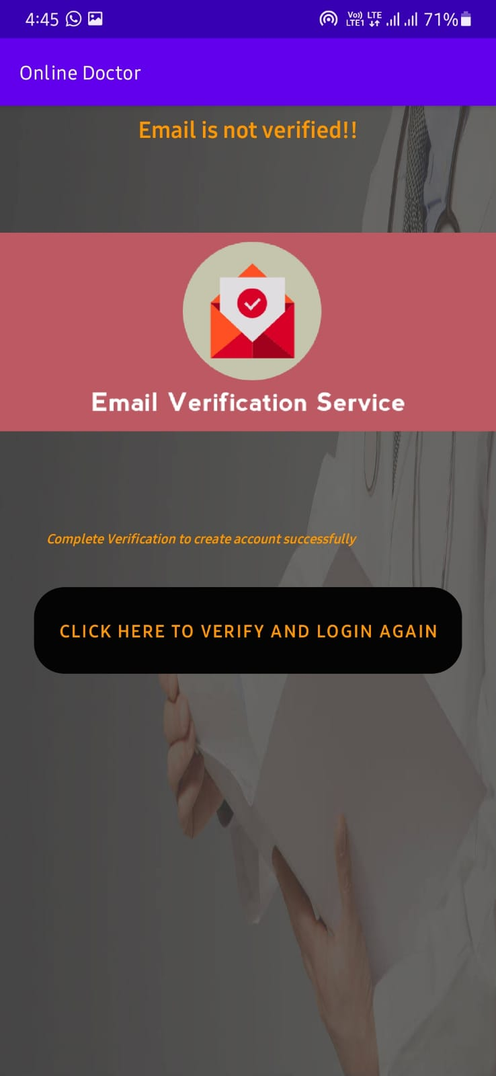
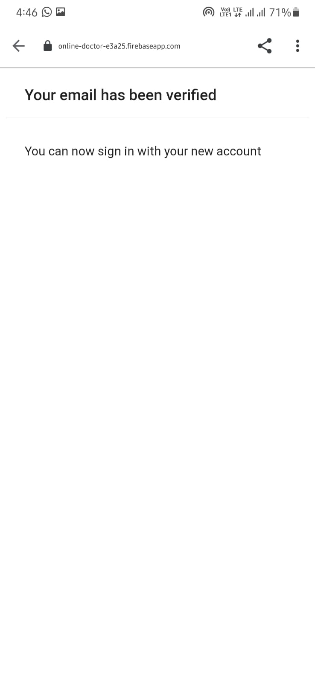
Email Verification
After successfully creating account users have to verified his or her email address…

Slide 22
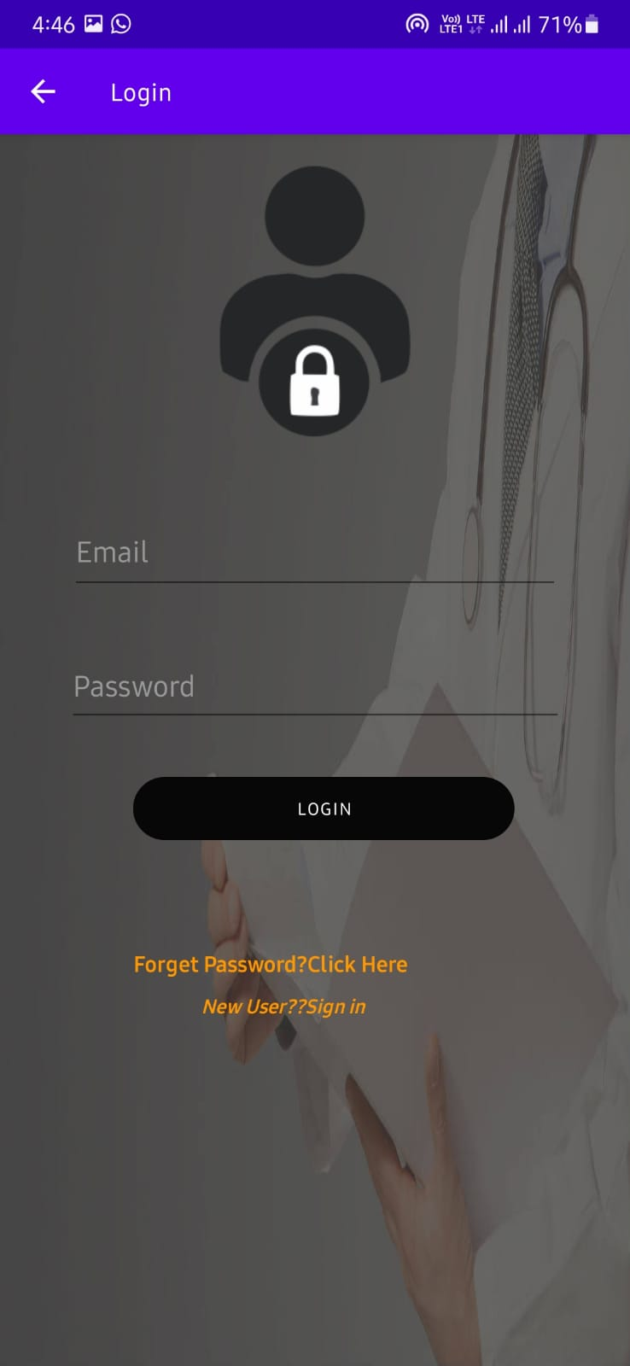
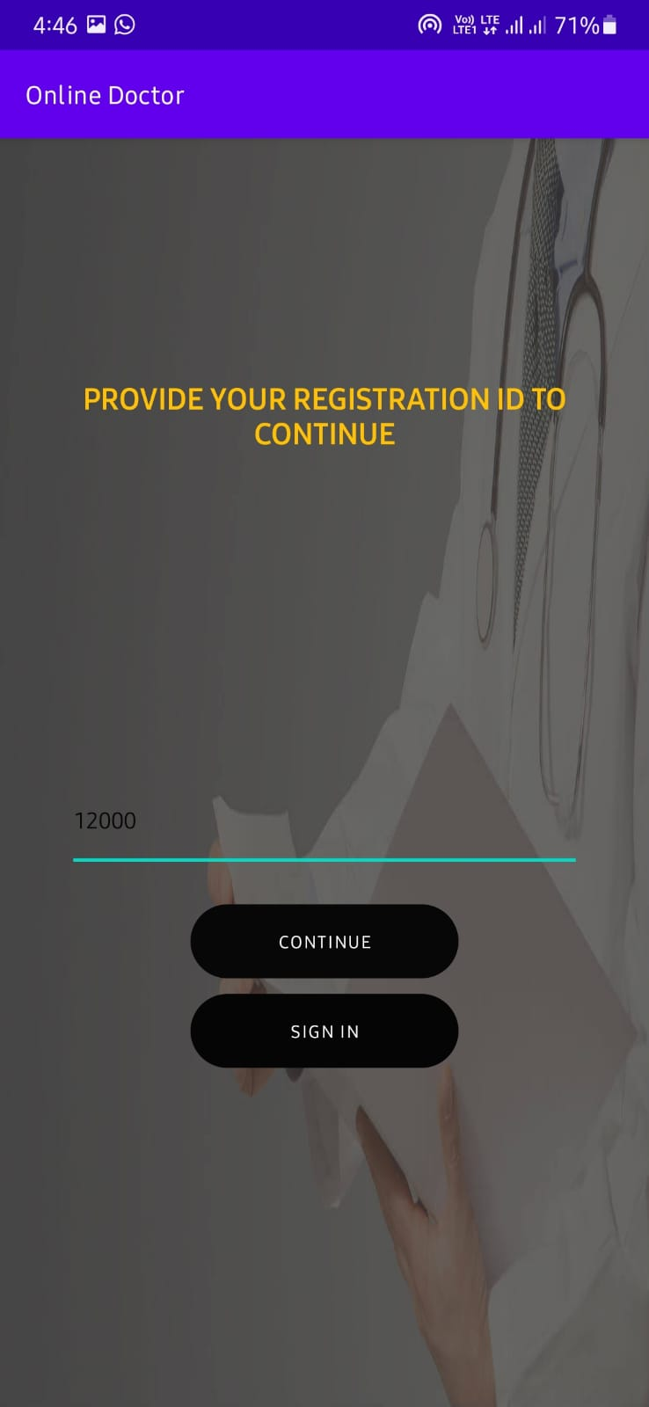
Login View
Log in Page
Only when doctor want to login, he or she have to provide registration id…
When Doctor or Patient want to login his/her account…

Slide 23
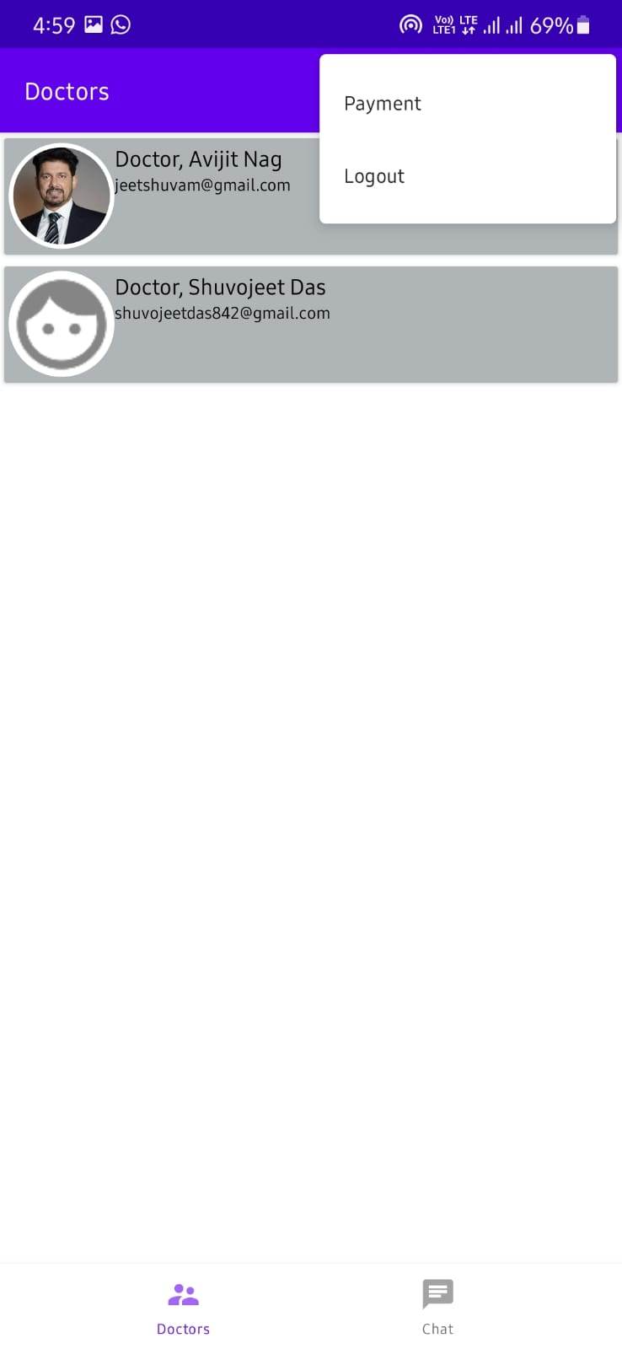
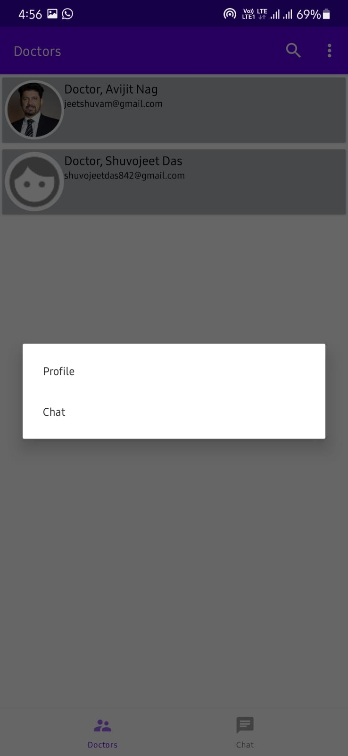
Patient’s View
Here is the list of doctors and one menu bar from where patient can pay doctor’s fees and sign out…
When click on the doctor, patient can view doctor's profile and do chat…

Slide 24
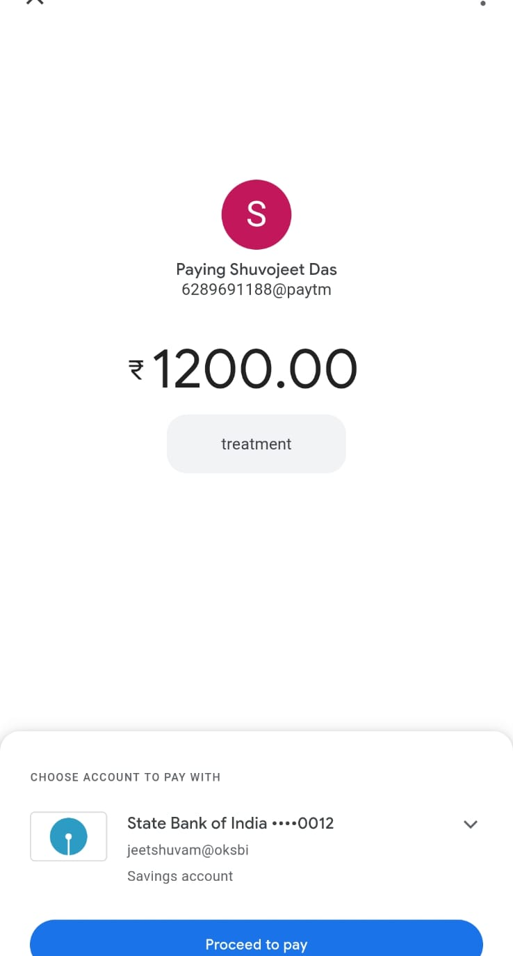
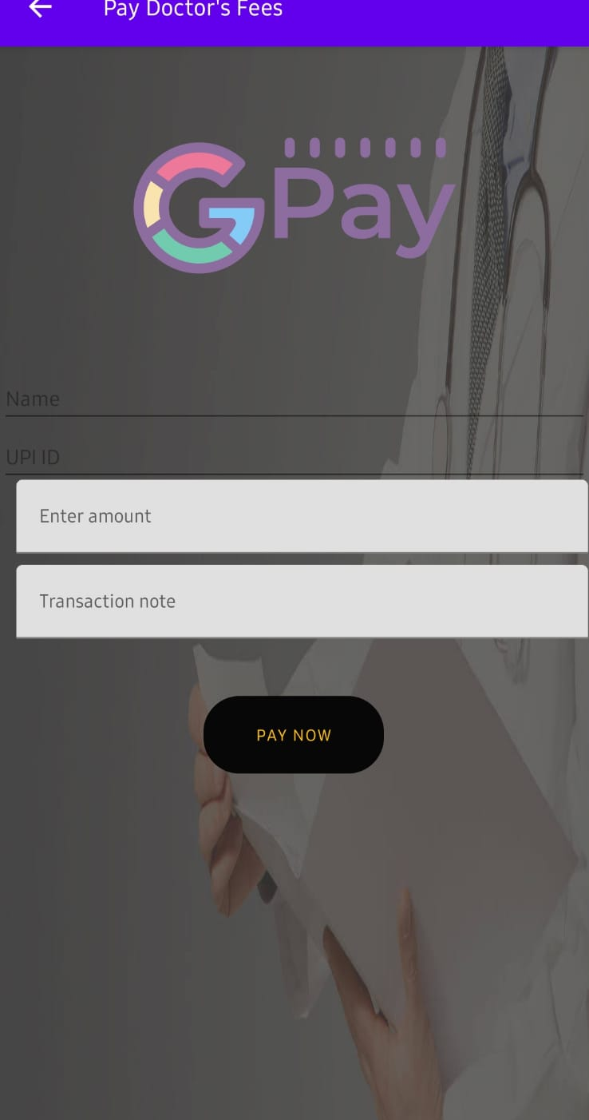
Payment View
Patient can pay doctor’s fees via Google pay from our app…

Slide 25
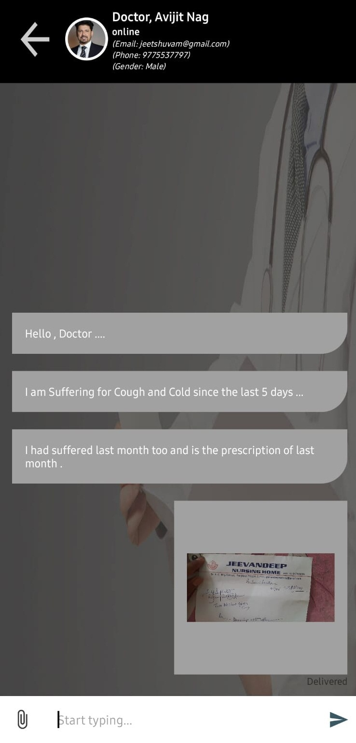
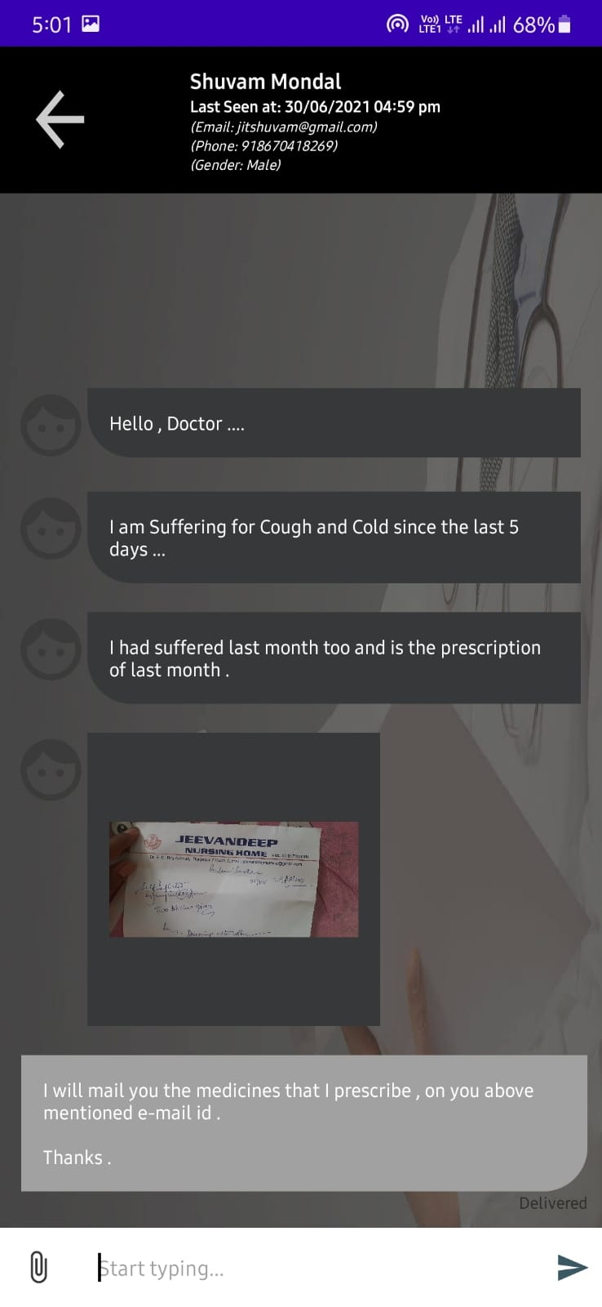
Chat box View
One patient message doctor and send a photo of his previous prescription…
Doctor replied the patient...

Slide 26
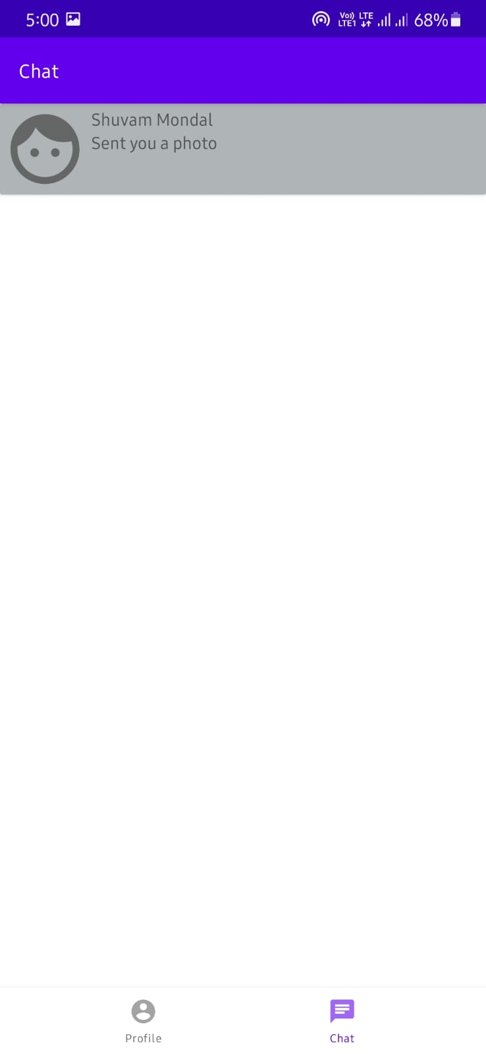
Chatlist
Whenever a patient send message to the doctor, it will be added in this list…

Slide 27
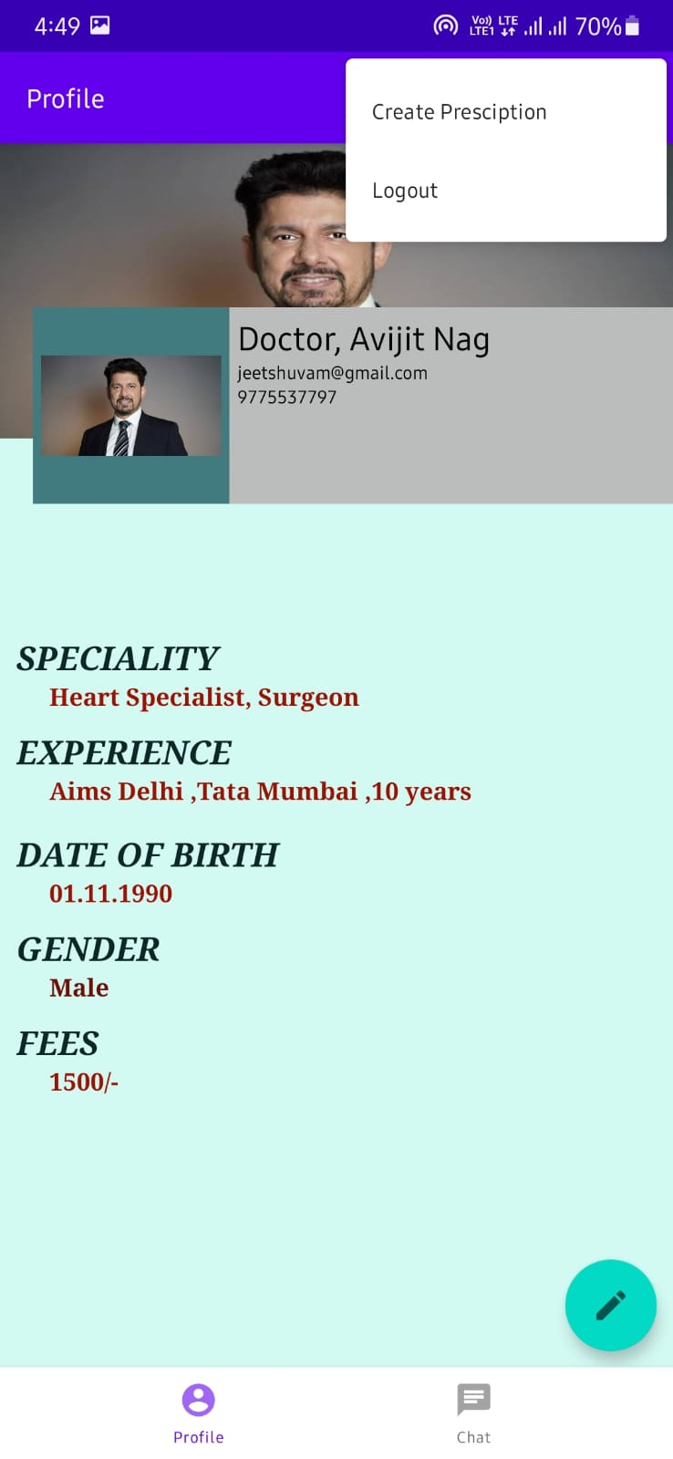
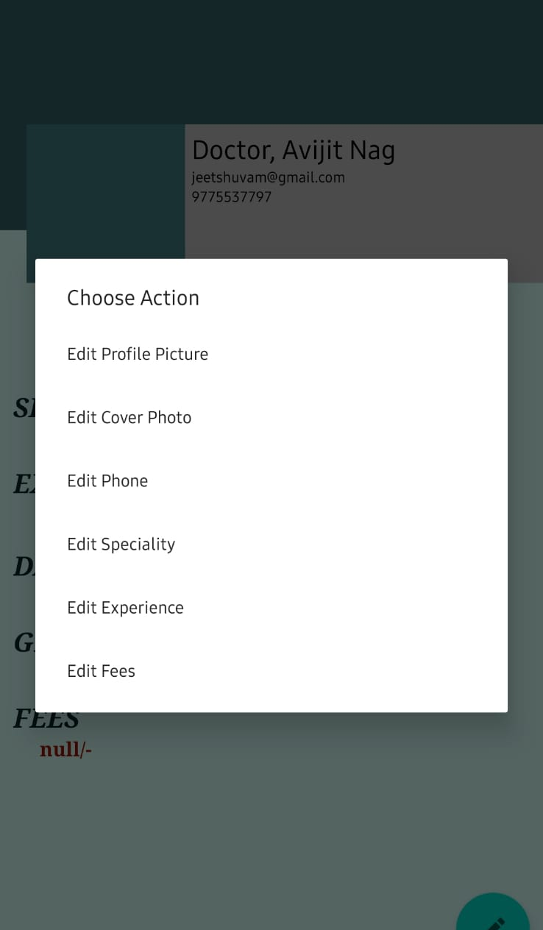
Doctor’s Profile…
Doctor can edit his/her profile and provide details and there is also a menu from which doctor can create prescription and sign out…

Slide 28
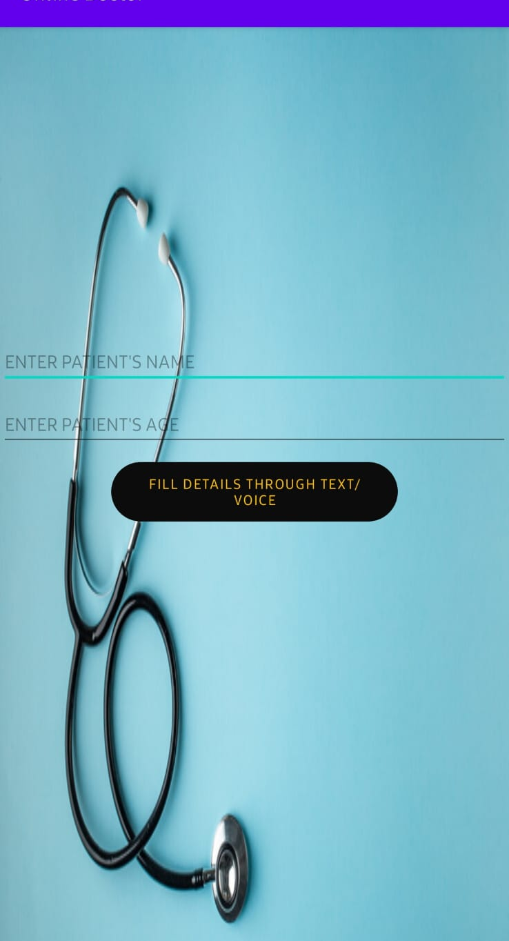
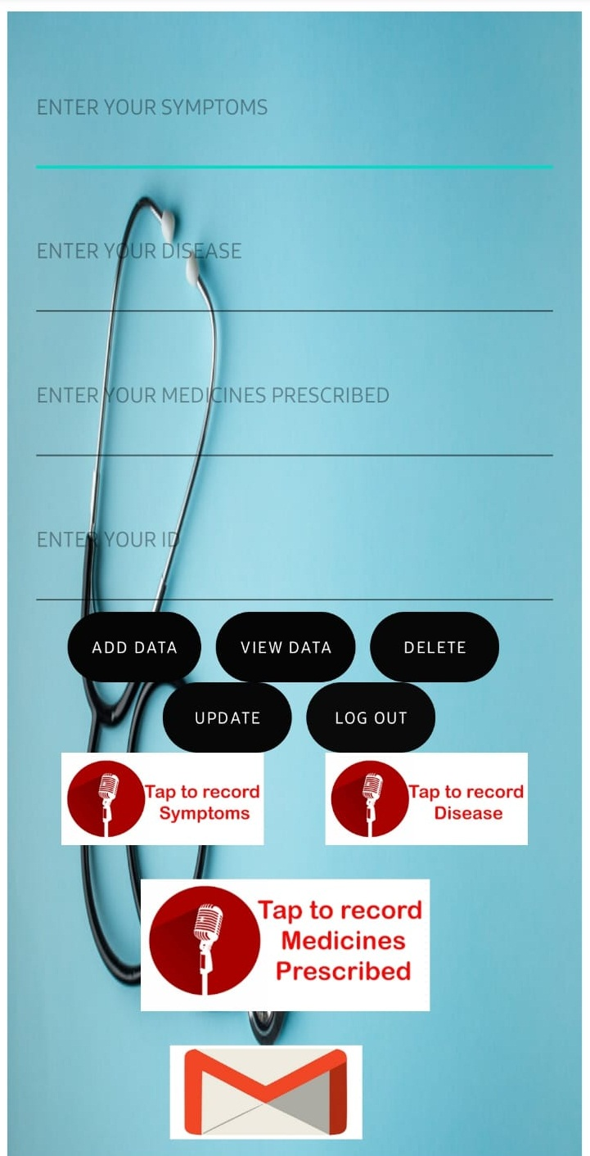
Prescription Creation
After Clicking create prescription doctor can fill the name and age of the patient and continue to next page…
After filling name and age doctor have to fill symptoms, disease medicines by his voice or text, then doctor can send prescription via mail…

Slide 29
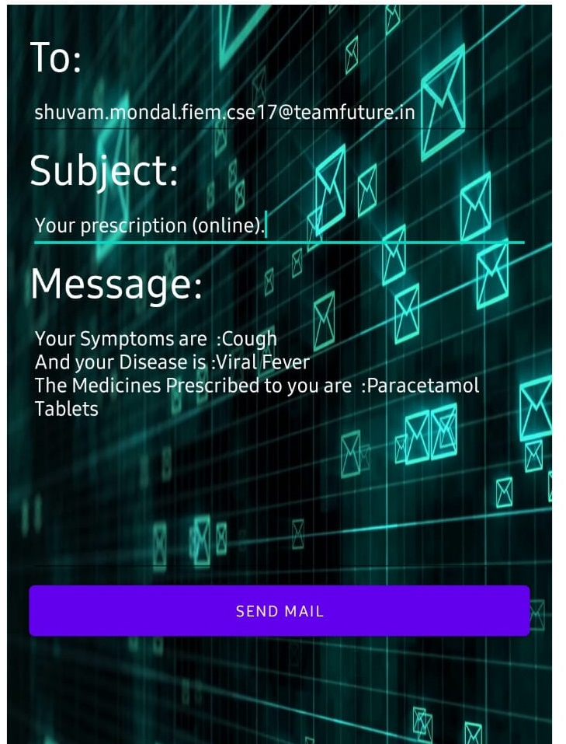
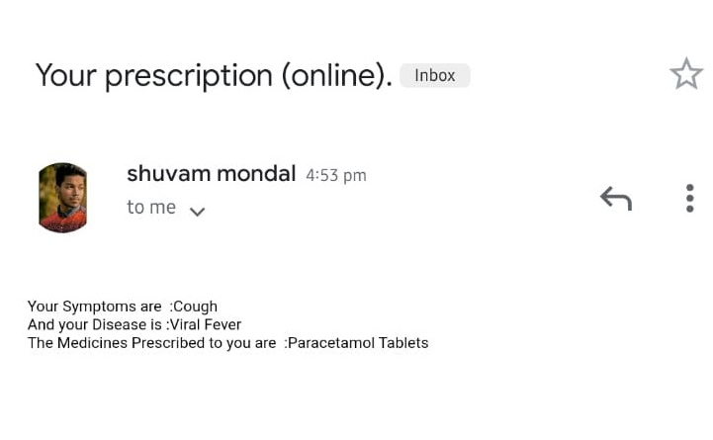
Digital Prescription
After clicking send prescription this is the next view and after that the e-prescription is received by the patient…

Slide 30
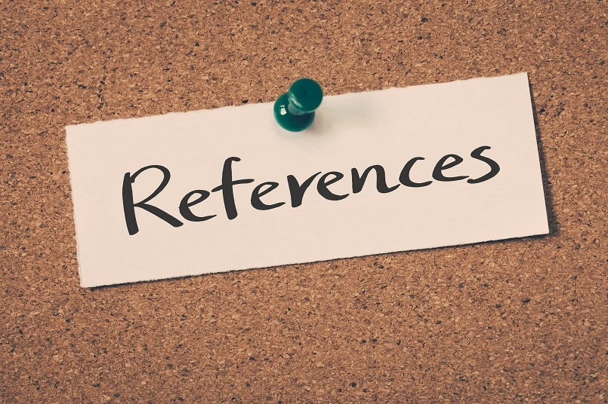
Reference
https://www.thedroidsonroids.com/blog/how-to-learn-android-development-programming
https://www.javatpoint.com/android-tutorial
https://developer.android.com/games/sdk/performance-tuner/custom-engine/enable-api
https://developer.android.com/training/permissions/requesting#:~:text=On%20all%20versions%20of%20Android,permissions%20that%20your%20app%20needs.

Slide 31
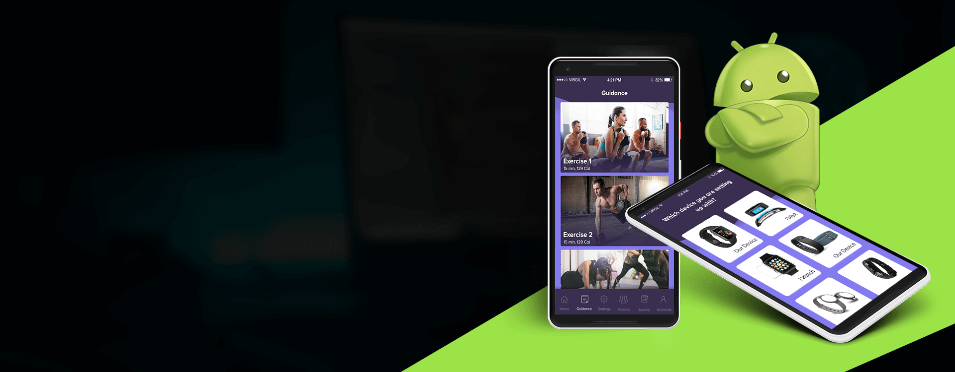
THANK YOU
Thank You

